Slide 1




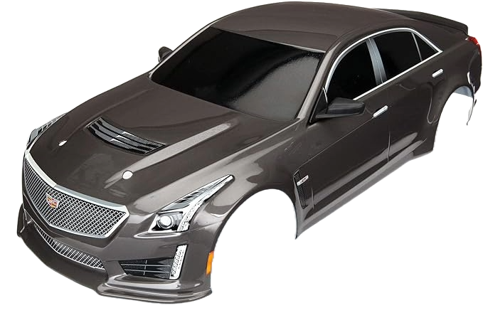
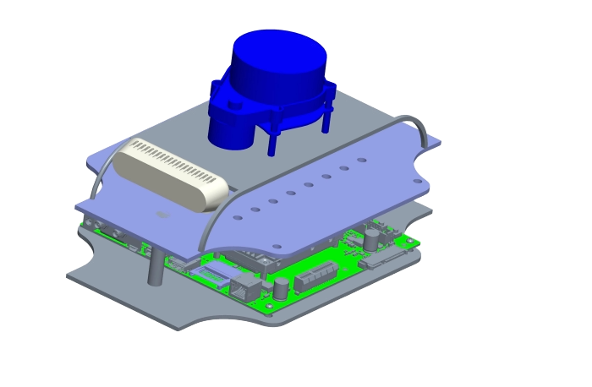
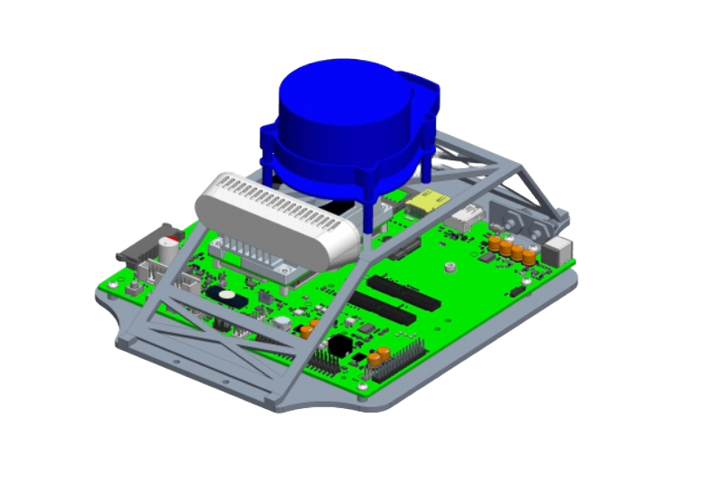
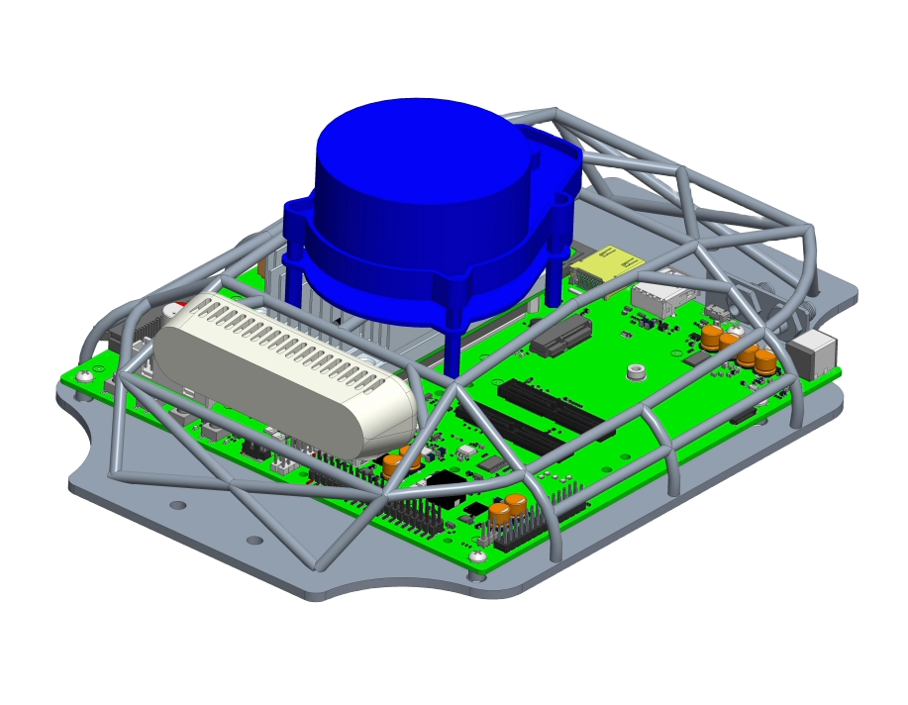
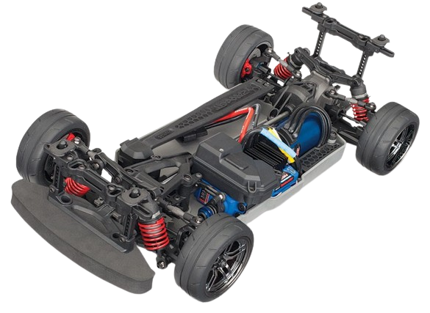
Formula 1/10th Vehicle
Team 503 | Kyle Lozano | Adam Imamura | Ja’Quan Young | Alex Soriano | Aaron Hastie
F1TENTH Body
Movement
Structure
Utilization
Protection
Project Description
Project Background
Functional Decomposition
Design and fabricate a 1/10th scale vehicle body that can house various autonomous driving components.
The F1TENTH project is an open-source autonomous racing project that promotes interest and excitement in autonomous systems through research, learning, building, and racing.
Key Goals
Strong and Resilient
Conveniently translatable to algorithm simulations
Design Concepts
Concept 1
Concept 2
Concept 3
Easily reproducible
Roll Cage
Future Work
Order all materials
Submit parts for fabrication
Assemble the design
Perform testing and validation
Prepare for Senior Design Day

